Slide 1
Career Paths With A Computer Science Major
Nicole Ignasiak, Trevor Waite, Nathan Pugh, & Josiah Hardacre
(Calc 1 + Trevor)

Slide 2
Introduction
There are many different career paths that a person with a computer science major could obtain. We hope in this speech to give four examples of these career paths. The job opportunities for a person with a computer science major are increasing as well. They are increasing because there is a high demand for people with the skills that a computer science major has to offer. This can be seen by the salaries and many job opportunities that there are in the computer science field.

Slide 3

Web Developer Duties
Design and create websites
Codes how the website looks and functions
Meet with client to see how they want their website to look
Make that website that meets their clients requirements
Update and maintain their websites

Slide 4
Web Developer Working Conditions
Usually work full time
Work in offices or at home
Quarter of them are self employed
*** Employment rate for this career is expanding ***
*** Ecommerce, online purchasing, and mobile use ***
*** Causes the demand for internet access to increase ***
*** Higher demand for web developers ***

Slide 5

Web Developer Requirements
Associate’s degree is a common requirement
If they have a more technical job, a bachelor’s degree is common
Have a thorough understanding of common website programming languages
HTML
C++
JavaScript

Slide 6
Applications Developer: Job Description
A person who writes computer programs to meet specific requirements
App developers design and develop application components
Mobile development is especially increasing
Many work for companies, but often times app developers are hired by private contractors
When would they work for a company?
When would they work for a private contractor?
Creativity!

Slide 7
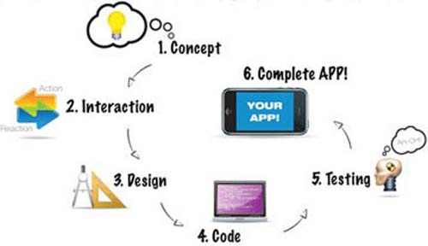
Applications Developer: Common Tasks
Write, modify, and debug software
Analyze situations and develop solutions
Depict requirements and turn them into technical designs
Test and document software

Slide 8


App Developer: Job Growth and Salary
The salary range is between about $49,000/year and $94,000/year with the median pay being about $66,000/year
Job growth between 2012 and 2020 is predicted to be 23%
App Development is a career that often leads into other career paths
Rapidly changing

Slide 9
Software Development: Job Description
Analyze users’ needs, then design, test, and develop software to meet those needs
Recommend software upgrades for customers’ programs and systems
Design pieces of the application or system and plan how they will work together
Create a variety of models and diagrams (such as flowcharts) that instruct programmers how to write the software code

Slide 10
Software Development: How to Become One
Software developers usually have a bachelor’s degree:
Computer Science
Mathematics
Developers must have a strong background in computer programming
Coding is fairly universal skill in all computer science fields.
Skills related to the industry that they are working in.
Career specifics

Slide 11
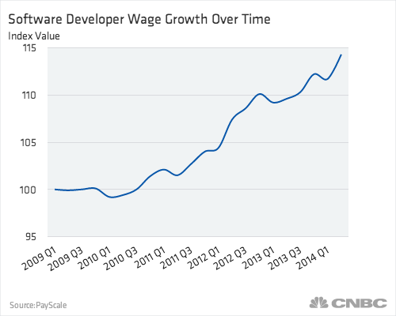
Software Developer: Salary and Pay
The average stays right around $93,000
The 90th percentile and up make near $120,000, while the lower make near $50,000.

Slide 12

Computer Programming: How To Become One
Bachelor’s Degree in Computer Science
Some companies hire people with an associate’s degree in computer science also.
Experience
College student internships help in the hiring process
College courses in this major help students obtain the skill of learning programming languages fast and efficiently, which is needed in the business world.

Slide 13
Computer Programming: What Programmers Do
Write code to create software programs.
They take a software developer’s program and turn it into code so that a computer can operate the program.
They make sure programs give them exactly what they were designed to give.
Duties:
Write in Languages like C++, Java, Python, etc.
Update and expand existing programs
Debug programs by testing and fixing errors

Slide 14
Computer Programming: Job Outlook
Employment of computer programmers is supposed to grow 8% from 2012-2022.
Programming can be done anywhere by using a computer, so some companies hire programmers from overseas or smaller parts of the United States to save money, because that country or those parts of the United States may have lower wages.
Many who work in related services and computer system design are in an industry that is expected to grow as a result of the increasing demand of new computer software.
The job demand of computer programming will stay high in the next coming years because technology is always increasing and becoming more complex, so if you have a computer science major you will great job security.

Slide 15
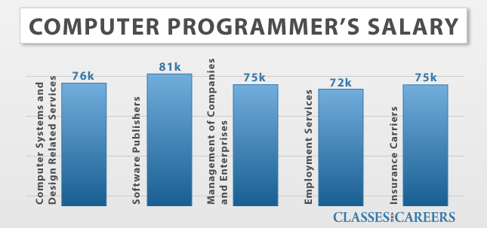
Computer Programming: Important Facts
Average yearly salary: Between $70k-$80k
Entry-Level Education: Bachelor’s degree (sometimes associate’s degree)
Number of jobs in 2012: 342,700
Job Outlook: 2012-2022 = 8%

Slide 16
Conclusion
There are many job opportunities with this major and we hope to have listed and explained four of them. They are being a web developer, an app developer, a software developer, and a computer programmer. As the employment rate and demand for people with a computer science major increases, we think it would be wise to consider computer science as a major. Computer science majors will have high job outlooks and high job security because there is always going to be a need for advancement in technology and for the upkeep of it.

Slide 17
Works Cited
“Application Developer Salary (United States).” PayScale.com. PayScale.com. Web. 19 Nov. 2015.
"Computer Programmers." Computer Programmers : Occupational Outlook Handbook : U.S. Bureau of Labor Statistics. U.S. Bureau of Labor Statistics, 8 Jan. 2014. Web. 19 Nov. 2015.
http://dictionary.reference.com/browse/application-developer
"Software Developers." Software Developers : Occupational Outlook Handbook : U.S. Bureau of Labor Statistics. U.S. Bureau of Labor Statistics, 8 Jan. 2014. Web. 19 Nov. 2015.
"Web Developers." Web Developers : Occupational Outlook Handbook : U.S. Bureau of Labor Statistics. U.S. Bureau of Labor Statistics, 8 Jan. 2014. Web. 19 Nov. 2015.

